Slide 1

GET YOUR VISION IN INDIAN
Poonamallee High Road Chennai, -600100
A
Project Report on
“ Redbus Data Scraping with Selenium &
Dynamic Filtering using Streamlit ”
Submitted in partial fulfilment of the requirement
For the award of the course
DATA SCIENC
SUBMITTED BY
SHALINI .R
[MDTM 30(DS-WD-T-B5)]

Slide 2
In this Redbus Data Scraping and Dynamic Filtering project, I've implemented a comprehensive solution that focuses on web scraping, data storage, and building a user-friendly interface for analyzing bus travel data across different states in India.
Why I Implemented This:
Purpose: The main goal is to make bus travel data more accessible and easier to navigate for users by centralizing the bus schedules, routes, fares, and availability from various states in India.
Problem Solved: People often face challenges finding relevant bus information, especially across multiple state transport websites. This app provides a one-stop solution where users can filter buses based on their preferences like bus type, route, price, and more.

Slide 3
How I Implemented This:
Data Scraping with Selenium:
I used Selenium to automate the extraction of bus details from the Redbus website, like bus names, routes, prices, seat availability, and timings.
Selenium interacts with dynamic web elements (like loading bus schedules) and pulls the data from Redbus into a structured format for further use.
Data Storage with MySQL:
After scraping, the data is stored in a MySQL database for persistent storage. This database allows for easy querying and filtering of data, ensuring that the user always sees the most up-to-date bus travel information.
MySQL also supports scaling, so as the data grows with more routes and states, the system can handle large volumes of information efficiently.
Dynamic Filtering and Frontend with Streamlit:
Streamlit is used to create an interactive web application where users can select bus details like routes, states, bus types, and more.
The filtering options allow users to get results in real-time, without needing to refresh the page or perform complex searches. The application dynamically pulls filtered data from MySQL based on the user's selections.
Rating Feature:
A rating feature allows users to rate the buses they traveled on, which is stored and updated in a CSV file for now (with future plans to move this to MySQL).
This feedback can be useful for other users to make informed decisions.

Slide 4
What I Implemented:
Web Scraping:
Scraping dynamic content from Redbus using Selenium for multiple states and their routes.
Data for routes, fares, bus types, and timings were extracted across state-run bus corporations.
Database Integration:
The scraped data is then processed using Pandas and stored in MySQL for easy querying and filtering.
I also ensured that the data is cleaned and validated, particularly handling missing or incorrect price data using Pandas.
Interactive UI in Streamlit:
Users can filter buses by state, route, bus type, price, seat availability, and even departure time.
The UI is simple and intuitive, using drop-down menus, sliders, and time inputs to make navigation easy.
Rating System:
Users can rate buses after booking, and the rating is stored for future reference.
The application also calculates and shows the average bus rating.
Booking and Summary:
After choosing their route, users get a detailed booking summary that includes the state, route, travel date, departure time, number of passengers, fare, and rating. This enhances user experience by giving them all the information they need before finalizing the booking.

Slide 5
Key Technologies Used:
Selenium: For web scraping dynamic content from Redbus.
Pandas: For data manipulation and cleaning.
MySQL: For efficient storage and querying of bus data.
Streamlit: For building the interactive front-end that allows real-time filtering and selection of bus routes.
CSV: Currently used for storing user ratings.

Slide 6
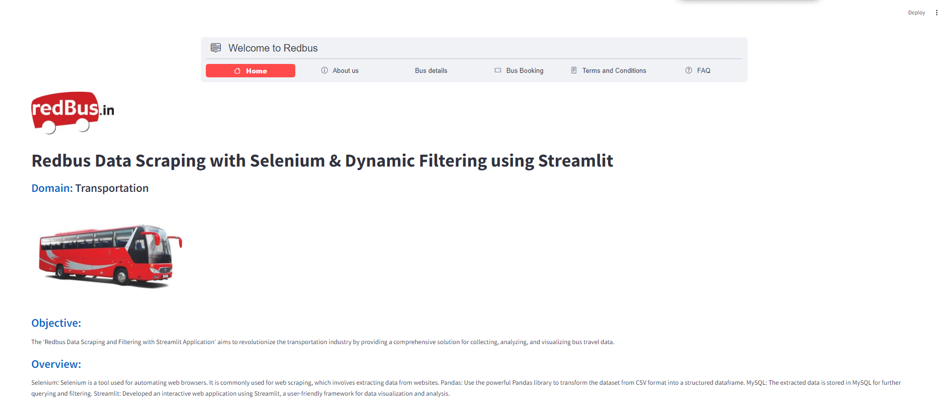
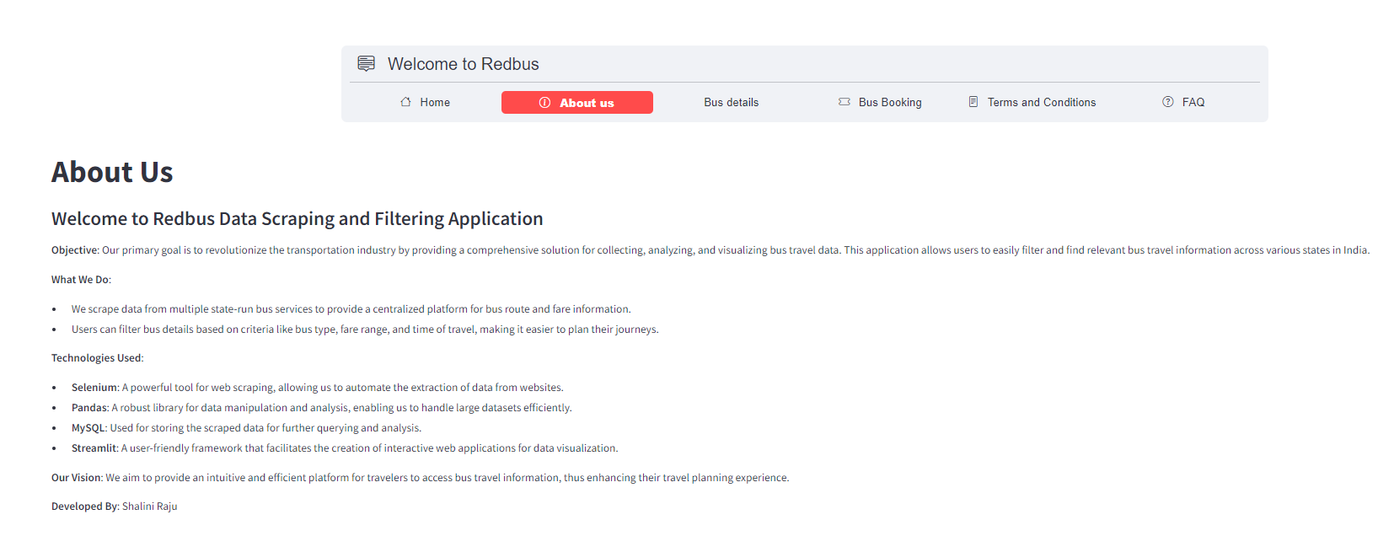
Out put screen

Slide 7
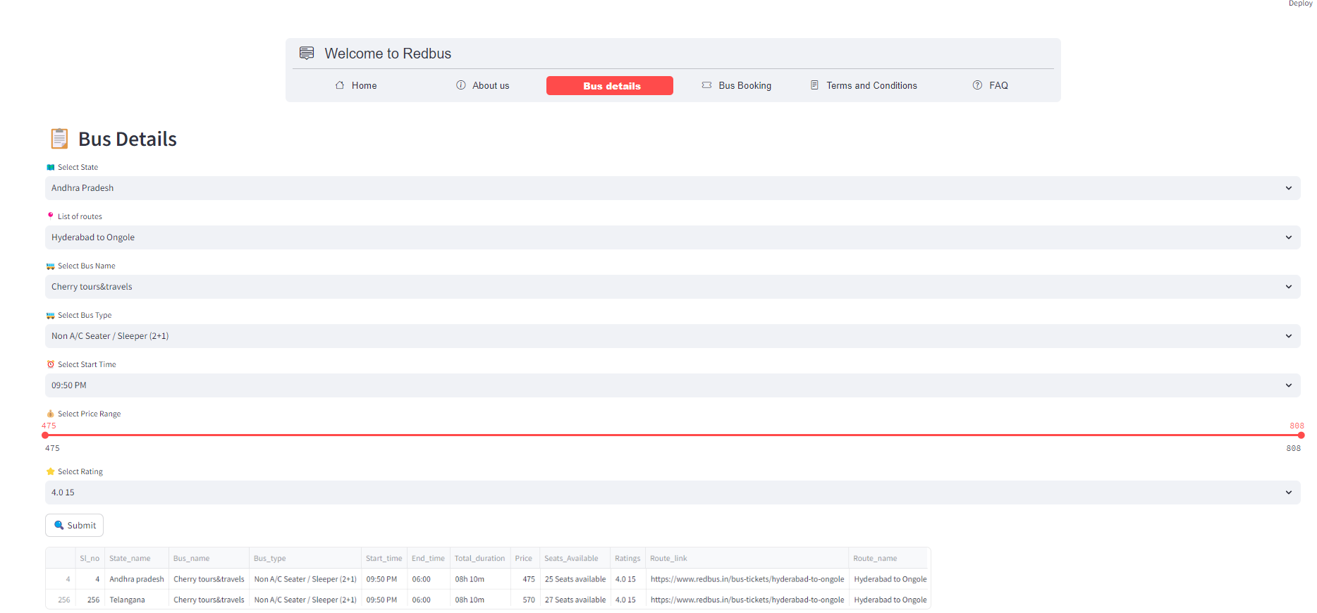

Slide 8
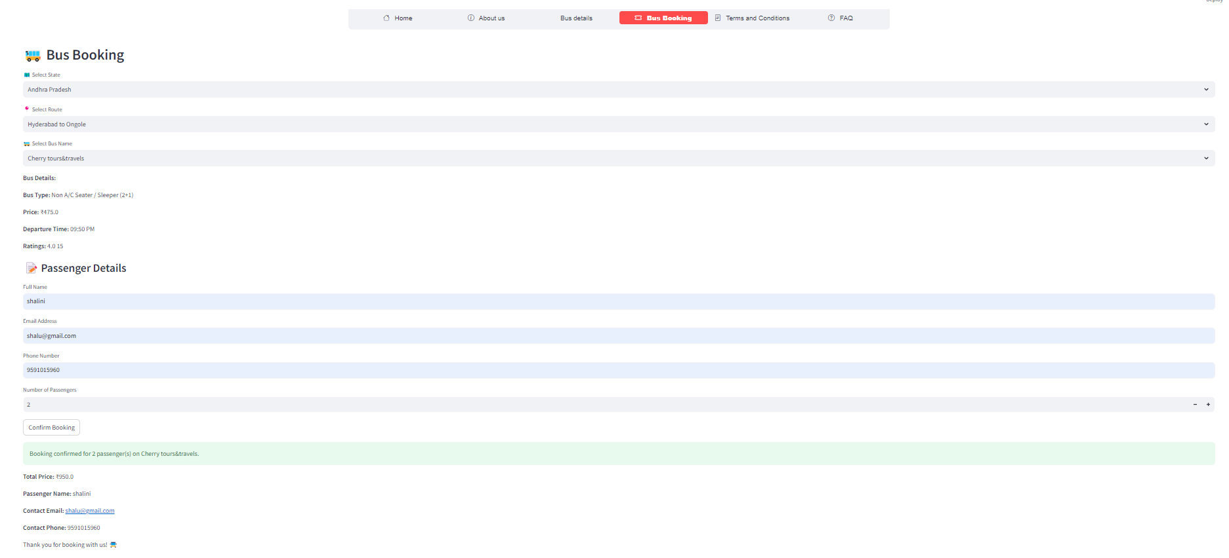

Slide 9
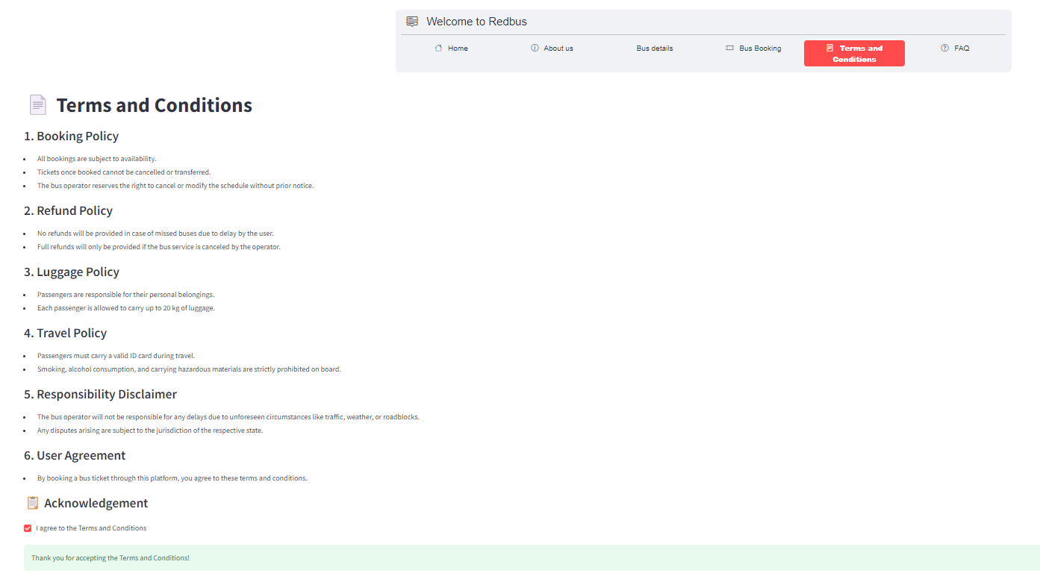

Slide 10
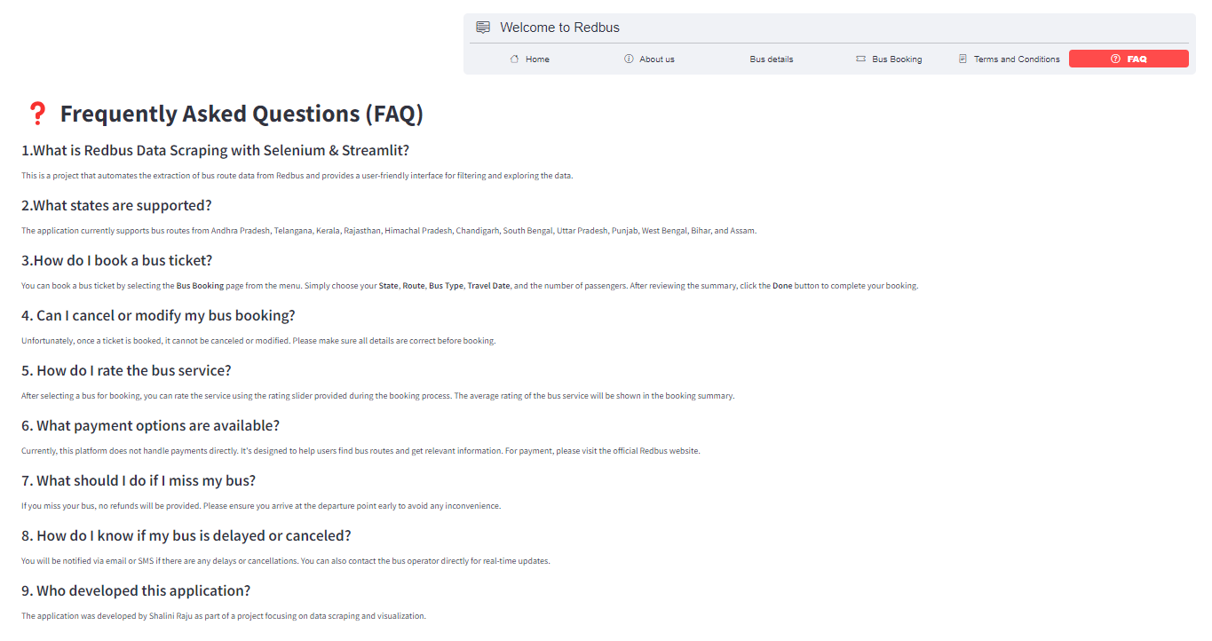

Slide 11
Questions

Slide 12
# Question 1. What is the Redbus Data Scraping Project?
The Redbus Data Scraping project is a web application that scrapes bus travel data from various state-run bus services. It allows users to filter and view bus details, including routes, bus types, prices, and availability using an interactive interface developed with Streamlit
# Question 2. How does the data scraping work?
The data is collected using Selenium, a web scraping tool that automates browser interactions to extract bus routes, timings, fares, and other details from the Redbus website. The scraped data is stored in a MySQL database for further querying and analysis.
# Question 3. What features does the app provide?
The application offers the following features: - Filtering of bus routes by state, seat type, and other criteria. - Viewing detailed bus information like prices, availability, timings, and user ratings. - Dynamic filtering of buses based on user preferences such as bus type, fare range, and seat availability. - Rating buses based on user experience.

Slide 13
# Question 4. What technologies are used in this project?
The project leverages several technologies: -
**Selenium** for scraping the Redbus portal.
**Pandas** for data manipulation.
**MySQL** for storing the scraped data.
**Streamlit** for building the interactive web application.
# Question 5. How do I filter bus data?
You can filter bus data by selecting your preferred **state**, **route**, **bus type**, and other criteria on the **Bus Booking** or **Bus Details** page. The data is dynamically filtered based on your input and is displayed instantly.
# Question 6. How is the scraped data stored?
The scraped data is stored in a **MySQL** database. This ensures that the data is accessible for querying and filtering in real-time while using the application.
# Question 7. Can I view and filter data for different states?
Yes, the application supports viewing and filtering data from multiple Indian states, including Andhra Pradesh, Telangana, Kerala, Rajasthan, and more.

Slide 14
THANK YOU

